Slide 1
3D Game Basic – Inventory GUIs
Unity3D Basic for Beginners
5th Class
Handityo Aulia Putra
handityo@kmu.ac.kr

Slide 2
Class 05 Mini Projects
Mini project 5-1:
Displaying multiple pickups of the same object with text
Mini project 5-2:
Displaying multiple pickups of the same object with multiple status icons
Mini project 5-3:
Revealing icons for multiple object pickups by changing the size of a tiled image
Mini project 5-4:
Displaying multiple pickups of different objects as a list of text via a dynamic List<> of PickUp objects
Mini project 5-5:
Displaying multiple pickups of different objects as text totals via a dynamic Dictionary<> of PickUp objects and "enum“ pickup types

Slide 3
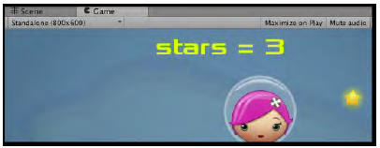
Displaying multiple pickups of the same object with text totals

Slide 4
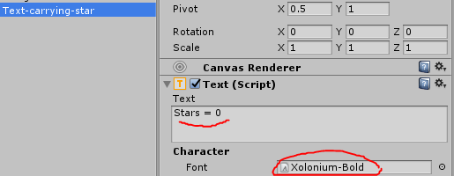
Displaying pickups (Text) – Steps
Continue from previous project or start with a new copy of the mini-game Simple2Dgame_SpaceGirl.
Add a UI Text object (Create | UI | Text).
Rename it Text-carrying-star. Change its text to “stars = 0”.
Import the provided Fonts folder into your project.

Slide 5
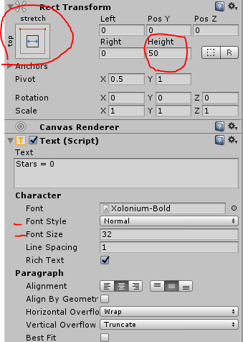
Displaying pickups (Text) – Steps
In the Inspector panel,
set the font of Text-carrying-star to Xolonium-Bold (folder Fonts) and
set its color to yellow.
Center the text horizontally and vertically,
set its Font Size to 32.
In its Rect Transform component,
set its Height to 50.
Edit its Rect Transform, and while holding down SHIFT and ALT (to set pivot and position), choose the top-stretch box.
Your text should now be positioned at the middle top of the Game panel, and its width should stretch to match that of the whole panel.

Slide 6
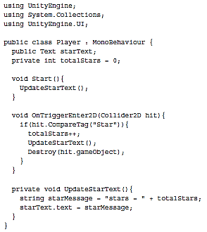
Displaying pickups (Text) – StepS
Edit previous Player Class or Add the following C# Script Player to GameObject player-SpaceGirl in the Hierarchy:

Slide 7
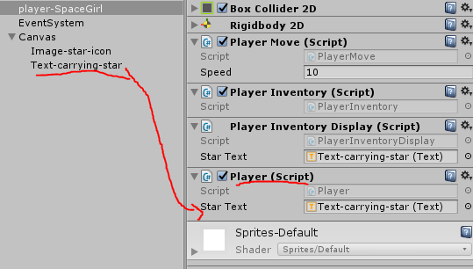
Displaying pickups (Text) – Step(3)
From the Hierarchy view,
select the GameObject player-SpaceGirl.
Then, from the Inspector,
access the Player (Script) component and
populate the Star Text public field with UI Text object Text-carrying-star.

Slide 8
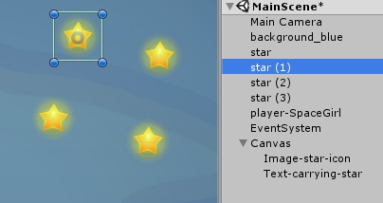
Displaying pickups (Text) – Step(3)
Select the GameObject star in the Hierarchy panel and make three more copies of this GameObject.
Move these new GameObject to different parts of the screen.
Play the game—each time you pick up a star, the total should be displayed in the form stars = 2.
Note: Use keyboard shortcut CTRL + D (Windows) or CMD + D (Mac) to quickly duplicate GameObjects.

Slide 9
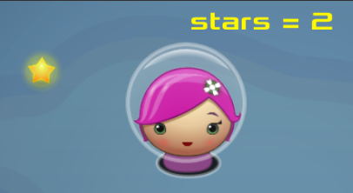
Displaying pickups (Text)
In the OnTriggerEnter2D() method,
the totalStars counter is incremented by 1 each time the player's character hits an object tagged Star.
The collided star GameObject is destroyed and a call is made to the UpdateStarText()method.

Slide 10

Displaying multiple pickups of the same object with multiple status icons

Slide 11
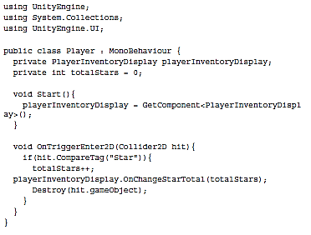
Displaying pickups (icons) – Step(1)
Edit the previous Project or Start with a new copy of the mini-game Simple2Dgame_SpaceGirl.
Add the following C# Script Player to GameObject player-SpaceGirl in the Hierarchy:

Slide 12
Displaying pickups (icons) – Step(2)
Select GameObject star in the Hierarchy panel and make three more copies of this GameObject
(Windows CTRL + D / Mac CMD + D).
Move these new GameObject to different parts of the screen.

Slide 13
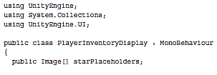
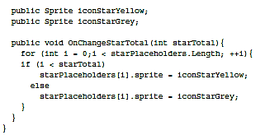
Displaying pickups (icons) – Step(3)
Add the following C# Script PlayerInventoryDisplay to the GameObject

Slide 14
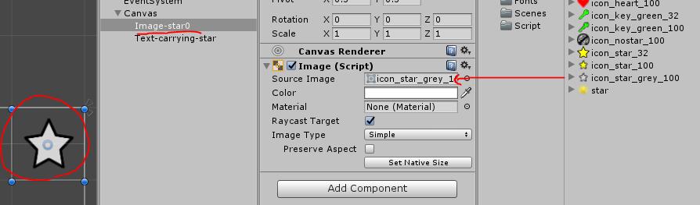
Displaying pickups (icons) – Step(4)
Select the Canvas in the Hierarchy panel and add a new UI Image object (Create | UI | Image). Rename it Image-star0.
Select Image-star0 in the Hierarchy panel.
From the Project panel, drag the sprite icon_star_grey_100 (folder Sprites) into the Source Image field in the Inspector for the Image component.
Click on the Set Native Size button for this for the Image component. This will resize the UI Image to fit the physical pixel width and height of sprite file icon_star_grey_100.

Slide 15
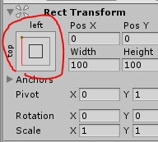
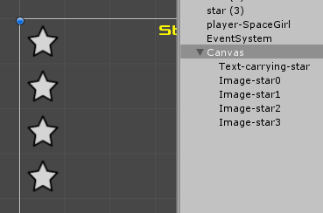
Displaying pickups (icons) – Step(5)
Now we will position our icon at the top and left of the Game panel.
Edit the UI Image's Rect Transform component, and while holding down SHIFT and ALT (to set pivot and position), choose the top-left box.
The UI Image should now be positioned at the top left of the Game panel.
Make three more copies of Image-star0 in the Hierarchy panel, naming them Image-star1, Image-star2, and Image-star3.

Slide 16
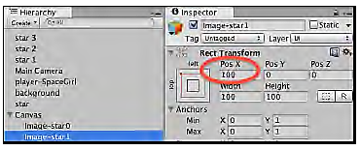
Displaying pickups (icons) – Step(6)
In the Inspector panel, change the Pos X position (in the Rect Transform component) of
Image-star1 to 100, of
Image-star2 to 200, and of
Image-star3 to 300, as shown in the following screenshot:

Slide 17
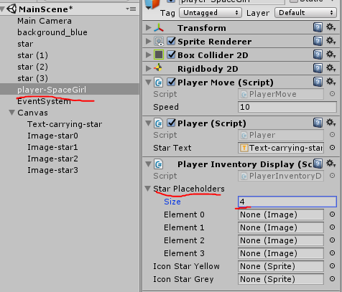
Displaying pickups (icons) – Step(7)
From the Hierarchy view,
select the GameObject player-SpaceGirl.
Then, from the Inspector,
access the Player Inventory Display (Script) component and set the Size property of public field Star Playholders to 4.
Next, populate the Element 0/1/2/3 array values of public field Star Playholders with UI Image objects Image-star0/1/2/3.

Slide 18
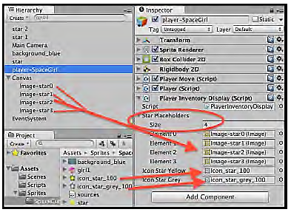
Displaying pickups (icons) – Step(8)
Now, populate the Icon Star Yellow and Icon Star Grey public fields from the Project panel with sprite icon_star_100 and icon_star_grey_100, as shown in the following screenshot:

Slide 19

Displaying pickups (icons)
In the OnTriggerEnter2D()method,
the totalStars counter is incremented by 1 each time the player's character hits an object tagged Star.
As well as destroying the hit GameObject,
the OnChangeStarTotal(…) method of the PlayerInventoryDisplay component is called, passing the new star total integer.
The OnChangeStarTotal(…)method of script class PlayerInventoryDisplay
has references to the four UI Images, and
loops through each item in the array of Image references,
setting the given number of Images to yellow, and the remaining to grey.
This method is public, allowing it to be called from an instance of script class Player.

Slide 20
Revealing icons for multiple object pickups by changing the size of a tiled image
Another approach that could be taken to show increasing numbers of images is to make use of tiled images.
The same visual effect as in the previous recipe can also be achieved by making use of a tiled grey star image of width 400 (showing four copies of the grey star icon), behind a tiled yellow star image, whose width is 100 times the number of stars collected.

Slide 21
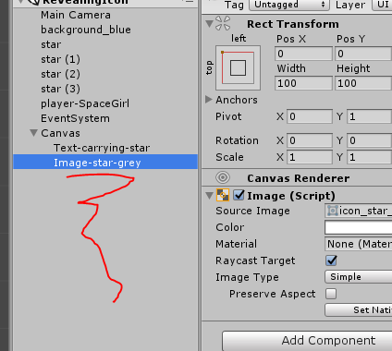
Revealing icons – Steps (1)
Make a copy of your work for the previous project.
In the Hierarchy panel, remove the four Image-star0/1/2/3 UI Images in the Canvas.
Select the Canvas in the Hierarchy panel and
add a new UI Image object (Create | UI | Image).
Rename it Image-stars-grey.
Select Image-stars-grey in the Hierarchy panel.

Slide 22
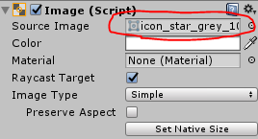
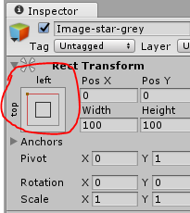
Revealing icons – Steps (2)
From the Project panel,
drag sprite icon_star_grey_100 (folder Sprites) into the Source Image field in the Inspector (in the Image (Script) component).
Click on the Set Native Size button for this for the Image component.
This will resize the UI Image to fit the physical pixel width and height of sprite file star_empty_icon.
Now we will position our icon at the top and left of the Game panel.
Edit the UI Image's Rect Transform component, and while holding down SHIFT and ALT (to set pivot and position), choose the top-left box.
The UI Image should now be positioned at the top left of the Game panel.

Slide 23
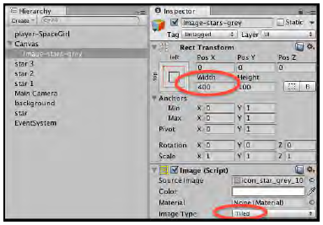
Revealing icons – Steps (3)
In the Inspector panel,
change the Width (in the Rect Transform component) of Image-stars-grey to 400.
Also, set the Image Type (in the Image (Script) component) to Tiled,

Slide 24
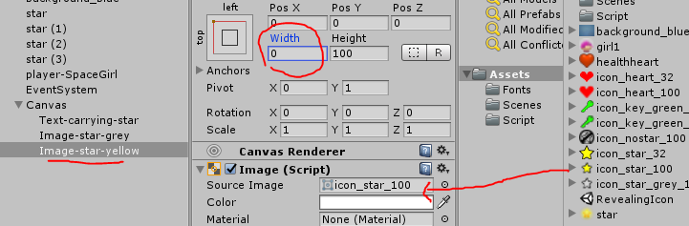
Revealing icons – Steps (4)
Make a copy of Image-stars-grey in the Hierarchy panel, naming the copy Image-stars-yellow.
With Image-stars-yellow selected in Hierarchy panel, from the Project panel, drag the sprite icon_star_100 (folder Sprites) into the Source Image field in the Inspector (in the Image (Script) component).
Set the width of Image-stars-yellow to 0 (in the Rect Transform component). So, now we have the yellow stars tiled image above the grey tiled image, but since its width is zero, we don't see any of the yellow stars yet.

Slide 25
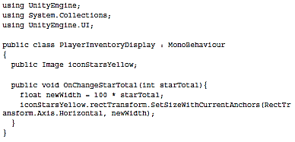
Revealing icons – Steps (5)
Replace the existing C# Script PlayerInventoryDisplay with the following code:

Slide 26
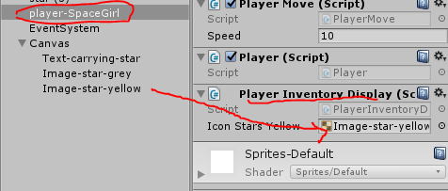
Revealing icons – Steps (6)
From the Hierarchy view,
select the GameObject player-SpaceGirl.
Then, from the Inspector,
access the Player Inventory Display (Script) component and
populate the Icons Stars Yellow public field with UI Image object Image-stars-yellow.

Slide 27
Revealing icons
Each time a star is picked up, a call is made to the OnChangeStarTotal(…)method of the script class PlayerInventoryDisplay , passing the new integer number of stars collected.
By multiplying this by the width of the yellow sprite image (100px),
we get the correct width to set for UI Image Image-stars-yellow so that the corresponding number of yellow stars will now be seen by the user.
Any stars that remain to be collected will still be seen as the grey stars that are not yet covered up.
The actual task of changing the width of UI Image Image-stars-yellow is completed by calling the SetSizeWithCurrentAnchors(…) method.
The first parameter is the axis, so we pass constant RectTransform.Axis.Horizontal so that it will be the width that is changed.
The second parameter is the new size for that axis—so we pass a value that is 100 times the number of stars collected so far (variable newWidth).

Slide 28
Displaying multiple pickups of different objects as a list of text via a dynamic List<> of PickUp objects

Slide 29
dynamic List<> of PickUp objects
In this project, we will learn
how each time an item is picked up, a new object is added to such a List collection.
An iteration through the List is how the text display of items is generated each time the inventory changes.
We will learn a very simple PickUp script class, demonstrating how information about a pickup can be stored in a scripted component, extracted upon collision, and stored in our List.

Slide 30
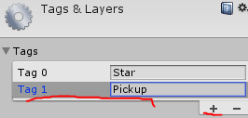
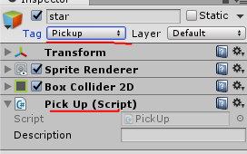

dynamic List<> of PickUp objects – Steps (1)
Start with a new copy of the mini-game Simple2Dgame_SpaceGirl.
Edit the tags, changing tag Star to Pickup. Ensure that the star GameObject now has the tag Pickup.
Add the following C# Script PickUp to GameObject star in the Hierarchy:

Slide 31
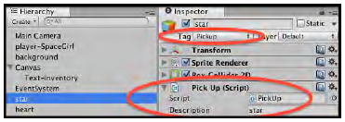
dynamic List<> of PickUp objects – Steps (2)
In the Inspector, change the description property of component Pick Up (Script) of GameObject star to the text star, as shown in the following screenshot:

Slide 32
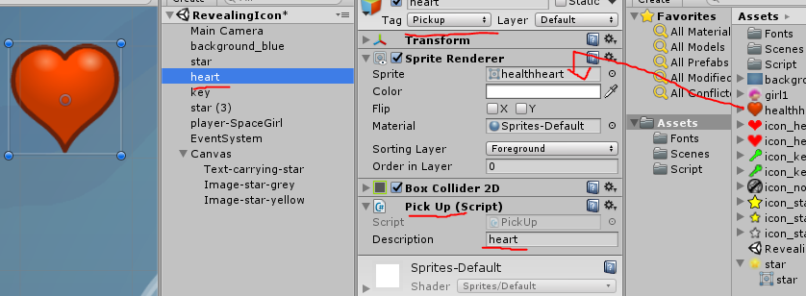
dynamic List<> of PickUp objects – Steps (3)
Select the GameObject star in the Hierarchy panel and make a copy of this GameObject, renaming the copy heart.
In the Inspector, change the description property of component Pick Up (Script) of GameObject heart to the text heart.
Also, drag from the Project panel (folder Sprites) image healthheart into the Sprite property of GameObject heart.
The player should now see the heart image on screen for this pickup item.

Slide 33
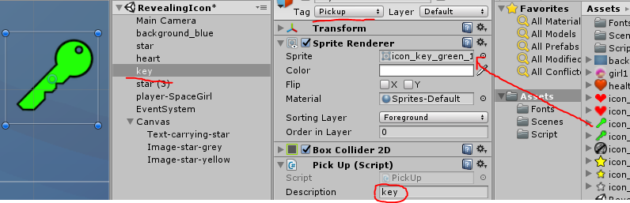
dynamic List<> of PickUp objects – Steps (4)
Select the GameObject star in the Hierarchy panel and make a copy of this GameObject, renaming the copy key.
In the Inspector, change the description property of component Pick Up (Script) of GameObject key to the text key.
Also, drag from the Project panel (folder Sprites) image icon_key_green_100 into the Sprite property of GameObject key.
The player should now see the key image on screen for this pickup item.

Slide 34
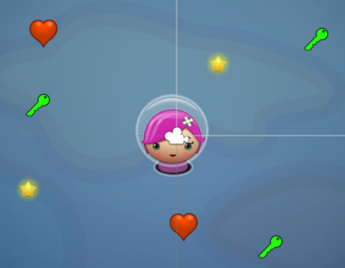
dynamic List<> of PickUp objects – Steps (5)
Make another one or two copies of each pickup GameObject and arrange them around the screen, so there are two or three each of star, heart, and key pickup GameObjects.

Slide 35
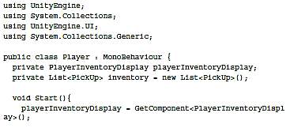
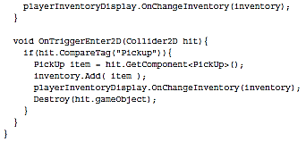
dynamic List<> of PickUp objects – Steps (6)
Add the following C# Script Player to GameObject player-SpaceGirl in the Hierarchy:

Slide 36
dynamic List<> of PickUp objects – Steps (7)
Add a UI Text object (Create | UI | Text).
Rename it Text-inventory-list.
Change its text to “the quick brown fox jumped over the lazy dog the quick brown fox jumped over the lazy dog”, or another long list of nonsense words, to test the overflow settings you change in the next step.
In the Text (Script) component, ensure that Horizontal Overflow is set to Wrap, and set Vertical Overflow to Overflow—this will ensure that the text will wrap onto a second or third line (if needed) and not be hidden if there are lots of pickups.

Slide 37
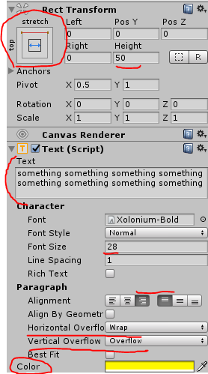
dynamic List<> of PickUp objects – Steps (8)
In the Inspector panel, set its font to Xolonium-Bold (folder Fonts) and set its color to yellow.
For the Alignment property, center the text horizontally and ensure that the text is top aligned vertically, and set the Font Size to 28 and choose a yellow text Color.
Edit its Rect Transform and set its Height to 50.
Then, while holding down SHIFT and ALT (to set pivot and position), choose the top-stretch box.
The text should now be positioned at the middle top of the Game panel, and its width should stretch to match that of the whole panel.
Your text should now appear at the top of the game panel.

Slide 38
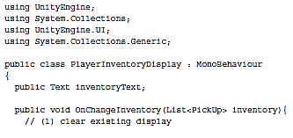
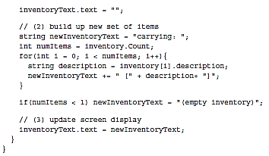
dynamic List<> of PickUp objects – Steps (7)
Add the following C# Script PlayerInventoryDisplay to GameObject player-SpaceGirl in the Hierarchy:

Slide 39
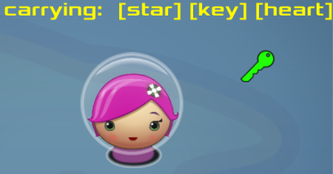
dynamic List<> of PickUp objects – Steps (8)
From the Hierarchy view, select the GameObject player-SpaceGirl.
Then, from the Inspector, access the Player Inventory Display (Script) component and populate the Inventory Text public field with the UI Text object Text-inventory-list.
Play the game—each time you pick up a star or key or heart, the updated list of what you are carrying should be displayed in the form carrying: [key] [heart].

Slide 40
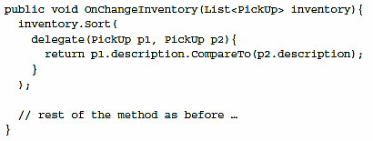
dynamic List<> of PickUp objects – sorting
If you want to sort the output to have an alphabetical order,
Add the following C# code to the beginning of method OnChangeInventory(...) in the script class PlayerInventoryDisplay:

Slide 41
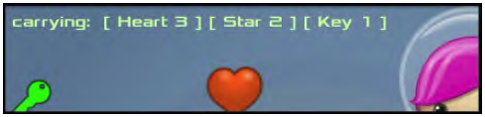
Displaying multiple pickups of different objects as text totals via a dynamic Dictionary<> of PickUp objects and "enum" pickup types

Slide 42
Multiple pickup (Enum)
In this project,
We will improve our general purpose PickUp class by introducing three possible pickup types (Star, Heart, and Key),
We will write inventory display code that counts the number of each type of pickup being carried and displays these totals via a UI Text object on screen.
We also switch from using a List to using a Dictionary,
since the Dictionary data structure is designed specifically for key-value pairs.
Perfect for associating a numeric total with an enumerated pickup type

Slide 43


Multiple pickup (Enum) – step (1)
1. Make a copy of your work for the previous recipe.
2. Replace the content of script class PickUp with the following code:

Slide 44
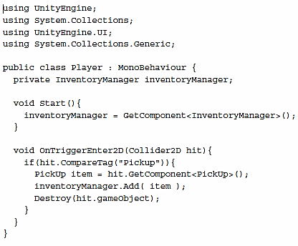
Multiple pickup (Enum) – step (2)
3. Replace the content of script class Player with the following code:

Slide 45
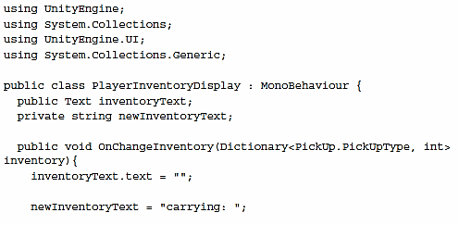
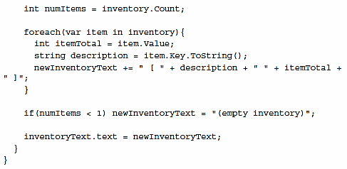
Multiple pickup (Enum) – step (3)
4. Replace the content of script class PlayerInventoryDisplay with the following code:

Slide 46
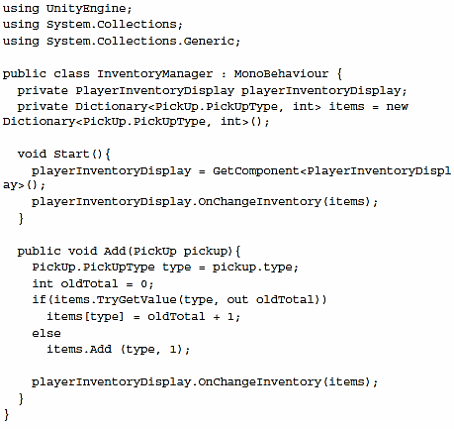
Multiple pickup (Enum) – step (4)
5. Add the following C# Script InventoryManager to the GameObject player-SpaceGirl in the Hierarchy:

Slide 47
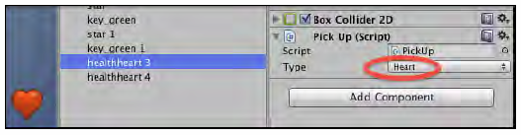
Multiple pickup (Enum) – step (5)
6. In the Hierarchy (or Scene) panel,
select each pickup GameObject in turn, and
choose from the drop-down menu its corresponding Type in the Inspector panel.
As you can see, public variables that are of an enum type are automatically restricted to the set of possible values as a combo-box drop-down menu in the Inspector panel.
7. Play the game.

Slide 48
Multiple pickup (Enum)
In this project, the inventory being carried by the player is being represented by a C# Dictionary.
In this case, we have in script class InventoryManager a dictionary of keyvalue pairs, where the key is one of the possible PickUp.PickUpType enumerated values, and the value is an integer total of how many of that type of pickup is being carried.
Each InventoryItemTotal object has just two properties: a PickUp type and an integer total.
Learn more about using C# lists and dictionaries in Unity in the Unity Technologies tutorial at https://unity3d.com/learn/tutorials/modules/intermediate/scripting/lists-and-dictionaries.

Slide 49
Project submission

Slide 50
Submit your project 5-5 to CTL
How to submit?
Create a package file for your final project
Asset | Export package, then select any resources that you use for the project.
It will create a single package file
Upload the unity package file to ctl.kmu.ac.kr

